Slide 1
Machine learning in Azure without Python/R
Krzysztof Pudłowski
Łódź 06.06.2019

Slide 2
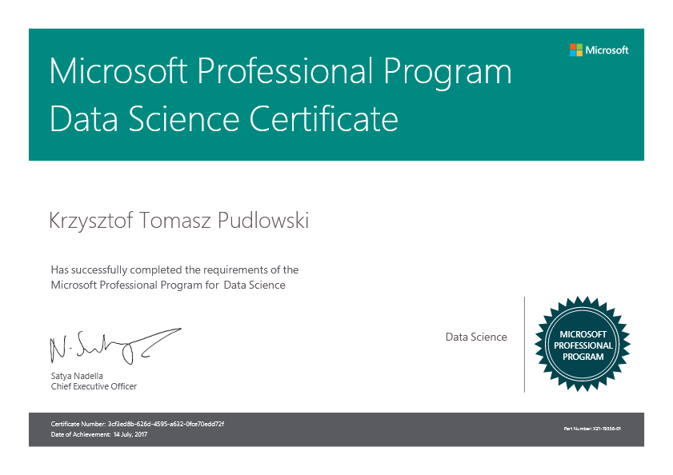

About me

Slide 3
Programming Languages in ML
https://www.geeksforgeeks.org/top-5-best-programming-languages-for-artificial-intelligence-field/
1. Python
2. C++
3. JavaScript
4. Java
5. C#
https://www.techrepublic.com/article/github-the-top-10-programming-languages-for-machine-learning/

Slide 4
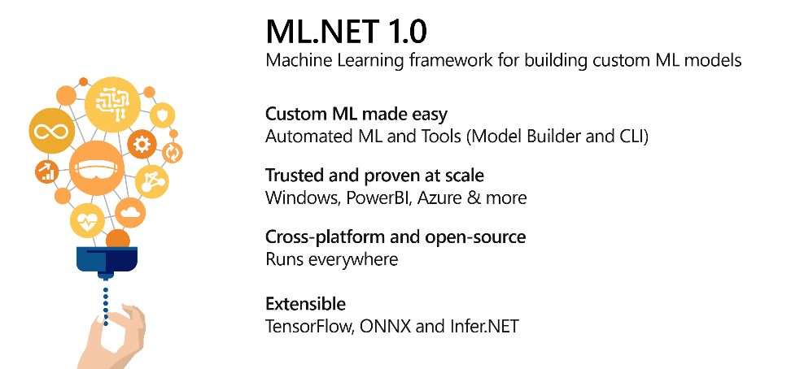
ML.NET
[Build 2019] Machine learning with ML.Net
https://blogs.msdn.microsoft.com/deva/2019/05/10/build-2019-machine-learning-with-ml-net/

Slide 5
ML.NET CREATORS
Before you begin to code
https://channel9.msdn.com/Shows/On-NET/Machine-Learning-with-MLNET-10-from-Build-2019
ML.NET is a free, cross-platform and open source machine learning framework designed to bring the power of machine learning (ML) into .NET applications.
Live from Build 2019, we are joined by Cesar De La Torre Llorente who gives us a great overview of what the goals of ML.NET are, and shares with us some of the highlights of the 1.0 release.

Slide 6
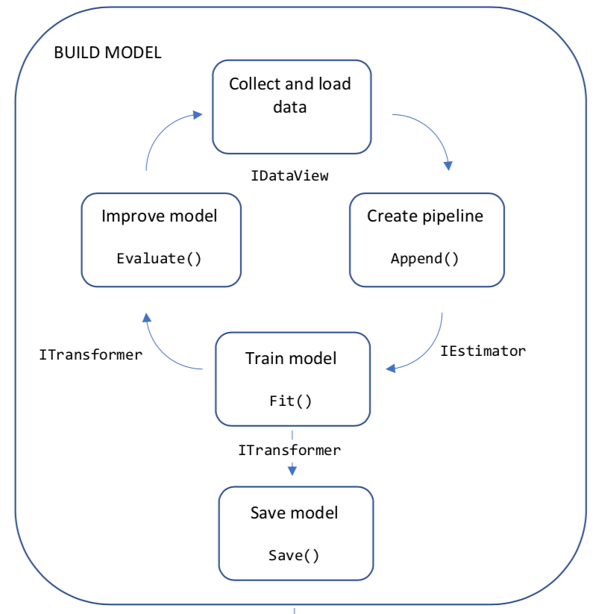
ML.NET PIPELINE BUILD MODEL

Slide 7
Hello world in ML.NET
//Step 1. Create a ML Context
var ctx = new MLContext();
//Step 2. Read in the input data for model training
IDataView dataReader = ctx.Data
.LoadFromTextFile<MyInput>(dataPath, hasHeader: true);
//Step 3. Build your estimator
IEstimator<ITransformer> est = ctx.Transforms.Text
.FeaturizeText("Features", nameof(SentimentIssue.Text))
.Append(ctx.BinaryClassification.Trainers
.LbfgsLogisticRegression("Label", "Features"));
//Step 4. Train your Model
ITransformer trainedModel = est.Fit(dataReader);
//Step 5. Make predictions using your model
var predictionEngine = ctx.Model
.CreatePredictionEngine<MyInput, MyOutput>(trainedModel);
var sampleStatement = new MyInput { Text = "This is a horrible movie" };
var prediction = predictionEngine.Predict(sampleStatement);

Slide 8
ML.NET PIPELINE BUILD MODEL
Collect Data
1. Using flat files
vendor_id,rate_code,passenger_count,trip_time_in_secs,trip_distance,payment_type,fare_amount
VTS,1,1,1140,3.75,CRD,15.5
VTS,1,1,480,2.72,CRD,10.0
VTS,1,1,1680,7.8,CSH,26.5
VTS,1,1,600,4.73,CSH,14.5
VTS,1,1,600,2.18,CRD,9.5
IDataView dataView = mlContext.Data.LoadFromTextFile<ModelInput>(dataPath, hasHeader: true, separatorChar: ',');
2. Using internal data
ModelInput[] modelData = {
new ModelInput() { Size = 1.1F, Price = 1.2F },
new ModelInput() { Size = 1.9F, Price = 2.3F },
new ModelInput() { Size = 2.8F, Price = 3.0F },
new ModelInput() { Size = 3.4F, Price = 3.7F } };
IDataView trainingData = mlContext.Data.LoadFromEnumerable(modelData);

Slide 9
ML.NET PIPELINE BUILD MODEL
Understand Data
vendor_id: The ID of the taxi vendor is a feature.
rate_code: The rate type of the taxi trip is a feature.
passenger_count: The number of passengers on the trip is a feature.
trip_time_in_secs: The amount of time the trip took. You want to predict the fare of the trip before the trip is completed. At that moment you don't know how long the trip would take. Thus, the trip time is not a feature and you'll exclude this column from the model.
trip_distance: The distance of the trip is a feature.
payment_type: The payment method (cash or credit card) is a feature.
fare_amount: The total taxi fare paid is the label.

Slide 10
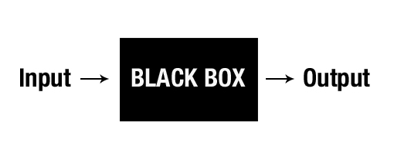
ML.NET PIPELINE BUILD MODEL
Define Input/Output Class
public class ModelInput
{
[LoadColumn(0)]
public string VendorId; [LoadColumn(1)]
public string RateCode; [LoadColumn(2)]
public float PassengerCount; [LoadColumn(3)]
public float TripTime; [LoadColumn(4)]
public float TripDistance; [LoadColumn(5)]
public string PaymentType; [LoadColumn(6)]
public float FareAmount;
}
public class ModelOutput
{
[ColumnName("Score")]
public float FareAmount;
}

Slide 11
ML.NET PIPELINE BUILD MODEL
Load data
MLContext mlContext = new MLContext();
IDataView dataView = mlContext.Data.LoadFromTextFile<ModelInput>
(dataPath, hasHeader: true, separatorChar: ',');

Slide 12
ML.NET PIPELINE BUILD MODEL
Create pipeline
Transforming data after loading
var pipeline = mlContext.Transforms.CopyColumns(outputColumnName: "Label", inputColumnName:"FareAmount")
// using categorical features
.Append(mlContext.Transforms.Categorical.OneHotEncoding(outputColumnName: "VendorIdEncoded", inputColumnName:"VendorId"))
.Append(mlContext.Transforms.Categorical.OneHotEncoding(outputColumnName: "RateCodeEncoded", inputColumnName: "RateCode"))
.Append(mlContext.Transforms.Categorical.OneHotEncoding(outputColumnName: "PaymentTypeEncoded", inputColumnName: "PaymentType"))
// all columns for input model -> concatenate to Features column
.Append(mlContext.Transforms.Concatenate("Features", "VendorIdEncoded", "RateCodeEncoded", "PassengerCount", "TripTime", "TripDistance", "PaymentTypeEncoded"))
// using regression algorithm
.Append(mlContext.Regression.Trainers.FastTree());

Slide 13
ML.NET PIPELINE BUILD MODEL
Create pipeline
Note:
All ML.NET algorithms look for an input column that is a vector. By default this vector column is called Features.

Slide 14
ML.NET PIPELINE BUILD MODEL
Train model
IDataView dataView = mlContext.Data.LoadFromTextFile<ModelInput>
(dataPath, hasHeader: true, separatorChar: ',');
// He we have transformations -> pipeline
var model = pipeline.Fit(dataView);

Slide 15
ML.NET PIPELINE BUILD MODEL
Note:
All algorithms also create new columns after they have performed a prediction. The fixed names of these new columns depend on the type of machine learning algorithm. For the regression task, one of the new columns is called Score.
https://docs.microsoft.com/en-us/dotnet/machine-learning/resources/tasks

Slide 16
ML.NET PIPELINE BUILD MODEL
Binary classification inputs and outputs
Output Column Name | Column Type | Description
Score | Single | The raw score that was calculated by the model
PredictedLabel | Boolean | The predicted label, based on the sign of the score. A negative score maps to false and a positive score maps to true.

Slide 17
ML.NET PIPELINE BUILD MODEL
Multiclass classification inputs and outputs
Output Name | Type | Description
Score | Vector of Single | The scores of all classes. Higher value means higher probability to fall into the associated class. If the i-th element has the largest value, the predicted label index would be i. Note that i is zero-based index.
PredictedLabel | key type | The predicted label's index. If its value is i, the actual label would be the i-th category in the key-valued input label type.

Slide 18
ML.NET PIPELINE BUILD MODEL
Regression inputs and outputs
Output Name | Type | Description
Score | Single | The raw score that was predicted by the model

Slide 19
ML.NET PIPELINE BUILD MODEL
Improve (evaluate) Model
IDataView dataView = mlContext.Data.LoadFromTextFile<ModelInput>
(_testDataPath, hasHeader: true,
separatorChar: ',');
var predictions = model.Transform(dataView);
var metrics = mlContext.Regression.Evaluate(predictions, "Label", "Score");

Slide 20

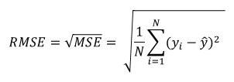
ML.NET PIPELINE BUILD MODEL
Model Metrics (for regression)
Metrics | Description | Look for
Squared-loss | Squared-loss or Mean Squared Error (MSE), also called Mean Squared Deviation (MSD)
RMS-loss | RMS-loss or Root Mean Squared Error (RMSE) (also called Root Mean Square Deviation, RMSD)

Slide 21


ML.NET PIPELINE BUILD MODEL
Model Metrics (for regression)
Metrics | Description | Look for
R-Squared | R-squared (R2), or Coefficient of determination
Absolute-loss | Absolute-loss or Mean absolute error (MAE)

Slide 22
ML.NET PIPELINE BUILD MODEL
Save Model
IDataView dataView = mlContext.Data.LoadFromTextFile<ModelInput>
(_trainDataPath, hasHeader: true, separatorChar: ',');
// Save/persist the trained model to a .ZIP file
mlContext.Model.Save(model, dataView.Schema,_modelPath);

Slide 23
ML.NET PIPELINE BUILD MODEL
Model structure
.
│ Schema
│
├───TrainingInfo
│ Version.txt
│
└───TransformerChain
│ Model.key
│
├───Transform_000
│ Model.key
│
├───Transform_001
│ │ Model.key
│ │
│ ├───Transform_000
│ │ │ Model.key
│ │ │
│ │ └───Vocabulary
│ │ Model.key
│ │ Terms.txt
│ │
│ └───Transform_001
│ Model.key
├───Transform_002
│ │ Model.key
│ │
│ ├───Transform_000
│ │ │ Model.key
│ │ │
│ │ └───Vocabulary
│ │ Model.key
│ │ Terms.txt
│ │
│ └───Transform_001
│ Model.key
│
└───Transform_003
│ Model.key
│ TrainSchema
│
└───Model
Model.key

Slide 24
ML.NET PIPELINE BUILD MODEL
Inside Model.zip (sample files)
Versiont.txt
1.0.27701.1 @BuiltBy: dlab14-DDVSOWINAGE100 @Branch: release/1.0
@SrcCode: https://github.com/dotnet/machinelearning/tree/b9c8eb861d1bd9425866e1ae92825b5dd7e62e2e+b9c8eb861d1bd9425866e1ae92825b5dd7e62e2e
Terms.txt
# Number of terms = 2
0 CMT
1 VTS
Terms.txt
# Number of terms = 5
0 CRD
1 CSH
2 NOC
3 DIS
4 UNK

Slide 25
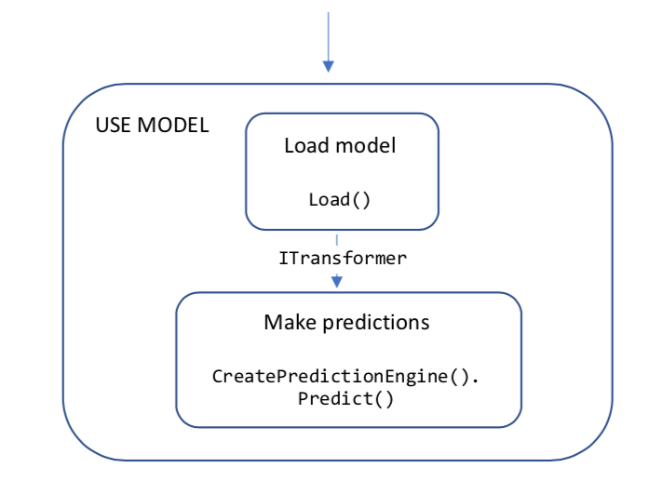
ML.NET PIPELINE USE MODE

Slide 26
ML.NET PIPELINE USE MODEL
Load Model
// Create MLContext MLContext
mlContext = new MLContext();
//Define DataViewSchema for data preparation pipeline and trained model
DataViewSchema modelSchema;
// Load trained model
ITransformer model = mlContext.Model.Load("model.zip", out modelSchema);

Slide 27
ML.NET PIPELINE USE MODEL
Make Prediction
var predictionFunction = mlContext.Model.CreatePredictionEngine<ModelInput, ModelOutput>(model);
// input class
var ModelnputExample = new ModelInput()
{
VendorId = "VTS",
RateCode = "1",
PassengerCount = 1,
TripTime = 1140,
TripDistance = 3.75f,
PaymentType = "CRD",
FareAmount = 0 // To predict. Actual/Observed = 15.5
};
var prediction = predictionFunction.Predict(ModelnputExample);
Console.WriteLine($"Predicted fare: {prediction.FareAmount:0.####}, actual fare: 15.5");

Slide 28
ML.NET CLI in Azure Cloud Shell
Linux Tools– bash, zsh, sh, tmux, dig
Azure Tools– Azure CLI, AzCopy, Service Fabric CLI
Programming Languages– .NET Core, Go, Java, Node.js, PowerShell, Python
Editors– vim, nano, emacs, code
Source Control– git
Build Tools– make, maven, npm, pip
Containers– Docker CLI / Docker Machine, Kubectl, Helm, DC/OS CLI
Databases– MySQL client, PostgreSQL client, sqlcmd utility, mssql-scripter
Other– iPython Client, Cloud Foundry CLI, Terraform, Ansible, Chef InSpec

Slide 29
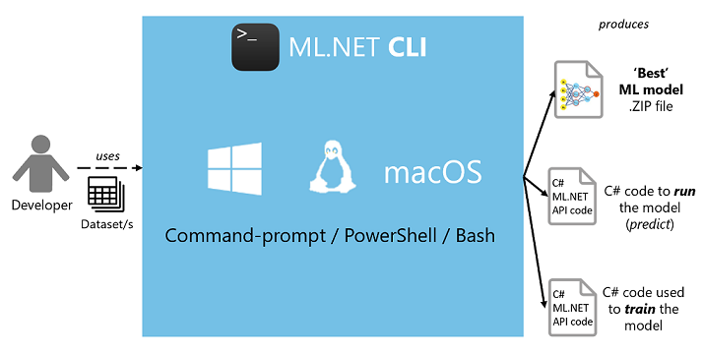
ML.NET CLI
http:// https://devblogs.microsoft.com/cesardelatorre/what-is-ml-net-1-0-machine-learning-for-net/

Slide 30
ML.NET CLI Limits
Limits
This is the first preview of Model Builder and has the following limitations. We are actively working on improving the experience in the future releases.
We currently support .tsv, .csv and SQL as the data-types you can use as datasets for the Model Builder. The files should have a header row. For this preview Model Builder does not support *.txt files or ';' separated or ',' separated files
Visual Studio 2017 15.9.12 or greater
Supported Visual Studio SKUs - Enterprise, Professional, and Community
There is a limit of 1GB on the training dataset.
SQL Server has a limit of 100K rows for training
Microsoft SQL Server Data Tools for Visual Studio 2017 is not supported.
https://github.com/dotnet/machinelearning-samples/tree/master/modelbuilder

Slide 31
ML.NET CLI in Azure Cloud Shell
DEMO
dotnet tool install -g mlnet
dotnet tool list -g
git clone https://github.com/djkormo/mlnet-cli.git

Slide 32
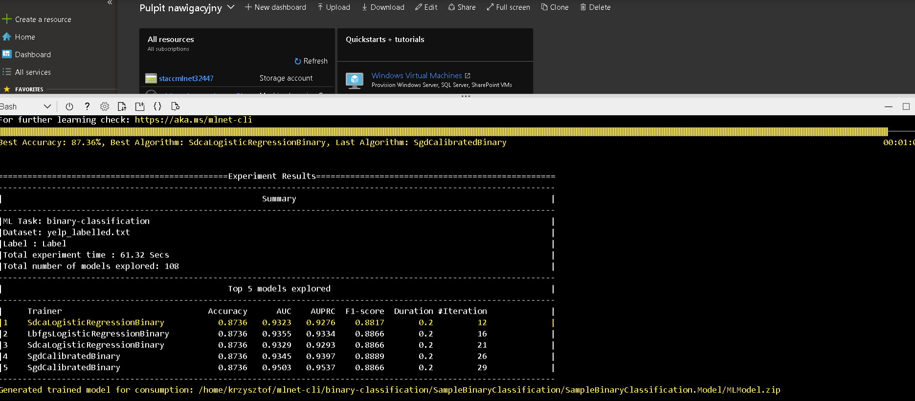
ML.NET CLI in Azure Cloud Shell

Slide 33
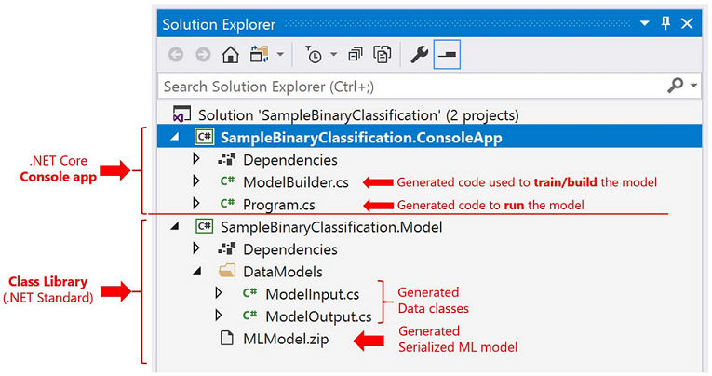
ML.NET CLI in Azure Cloud Shell
Structure of generated application

Slide 34
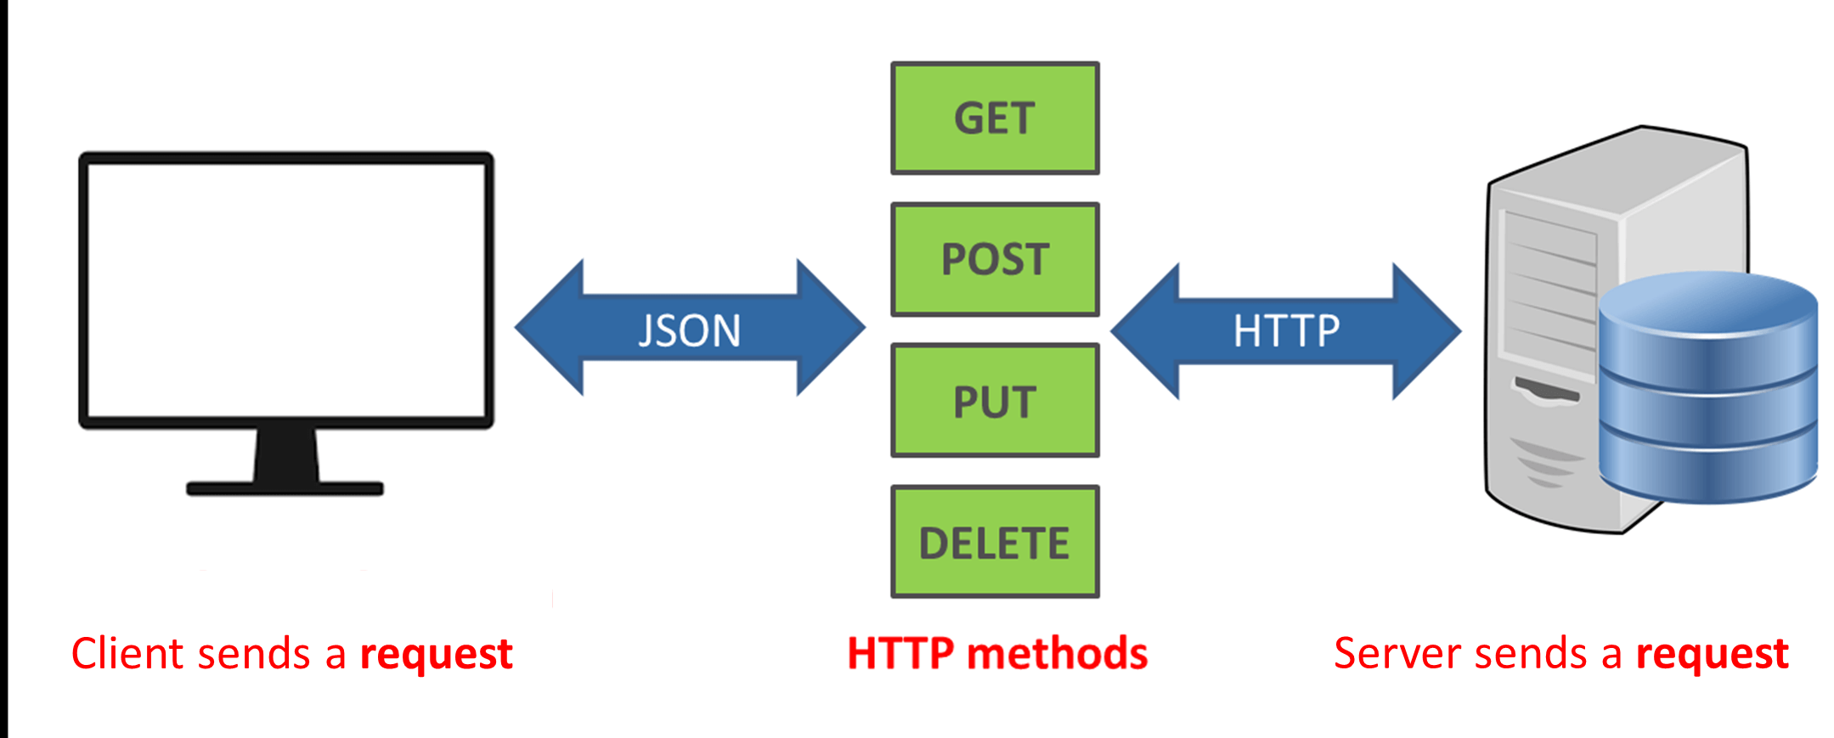
ML.NET building REST API
dotnet new webapi –o ml-net-webapi-test
cd ml-net-webapi-test
dotnet add package Microsoft.ML
dotnet add package Microsoft.Extensions.ML

Slide 35
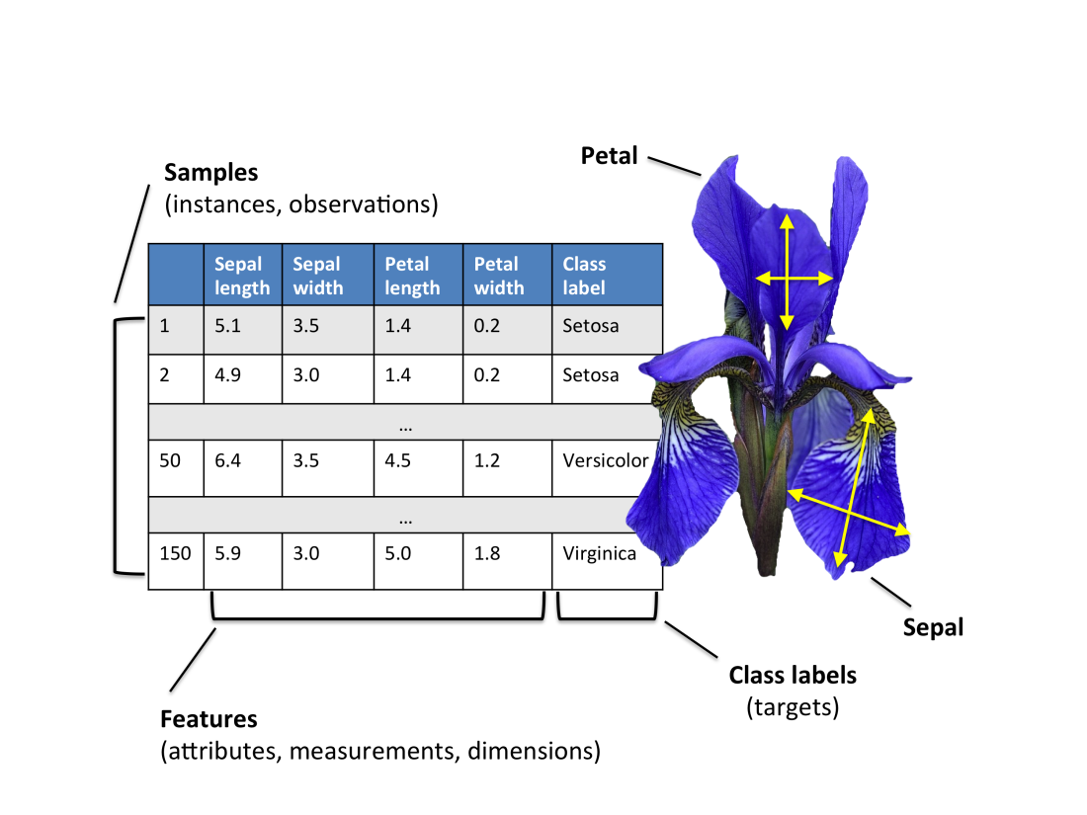
Iris set – multiclass classification
Question: How to predict Iris spieces
based on length and width of sepal and pepal leaves.

Slide 36
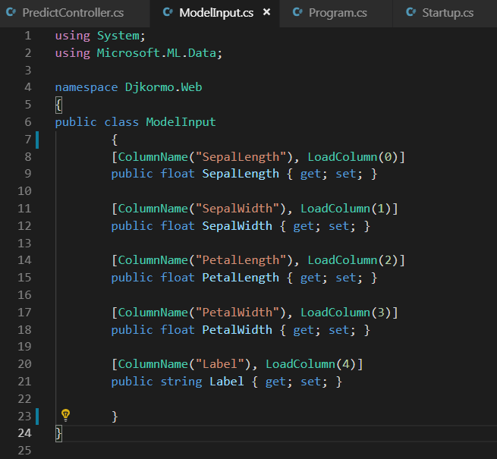
ML.NET building REST API
Input
Class

Slide 37
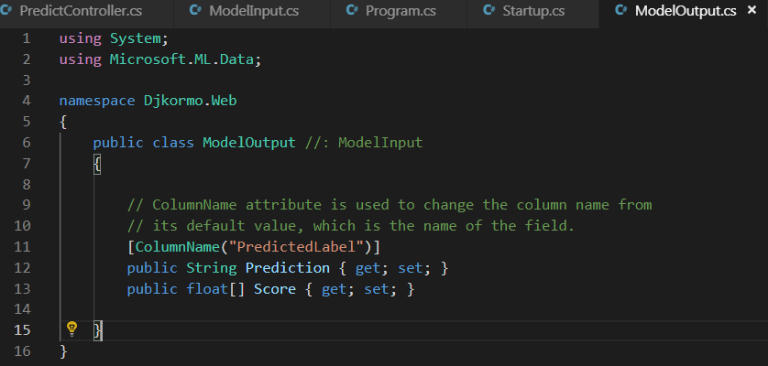
ML.NET building REST API
Output Class

Slide 38
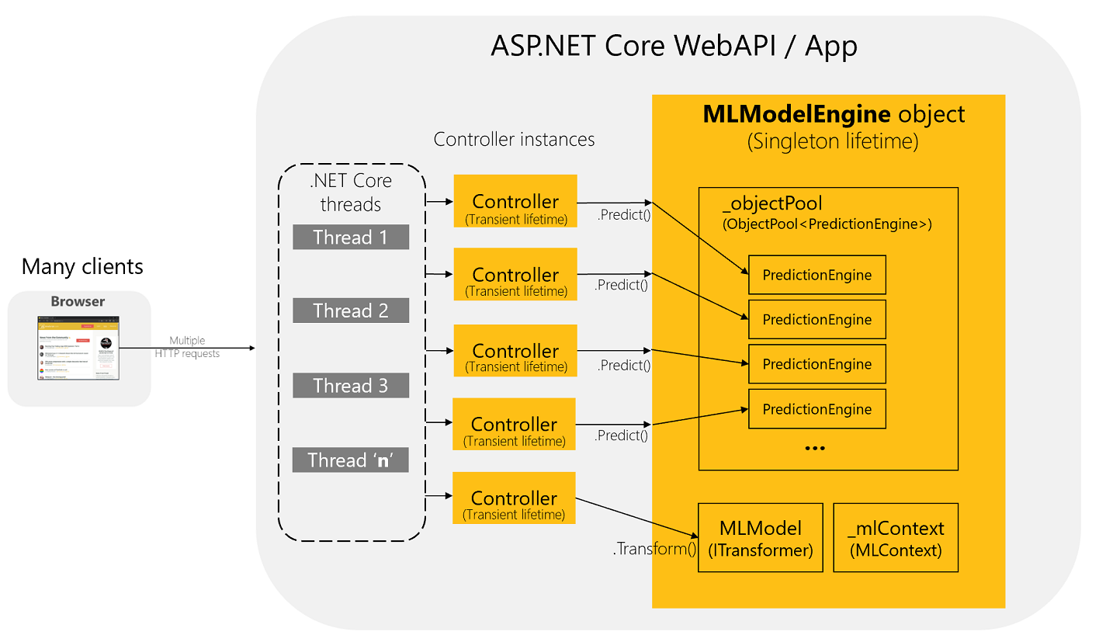
ML.NET building REST API
Warning
PredictionEngine is not thread-safe. For improved performance and thread safety, use the PredictionEnginePool service, which creates an ObjectPool of PredictionEngine objects for application use.
https://devblogs.microsoft.com/cesardelatorre/how-to-optimize-and-run-ml-net-models-on-scalable-asp-net-core-webapis-or-web-apps/

Slide 39
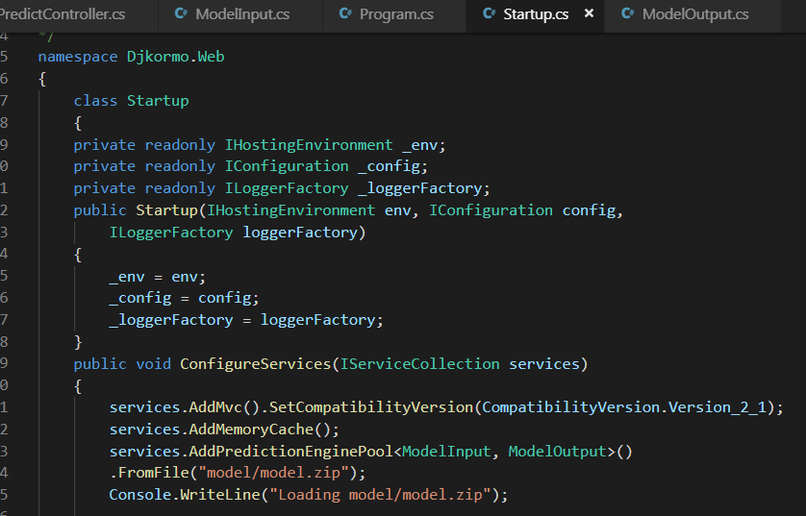
ML.NET building REST API
Startup
Class

Slide 40
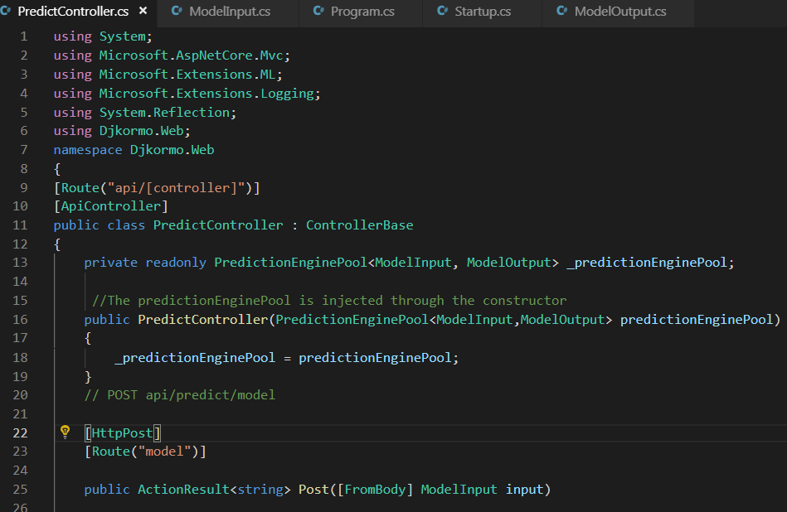
ML.NET building REST API
Controller Class

Slide 41
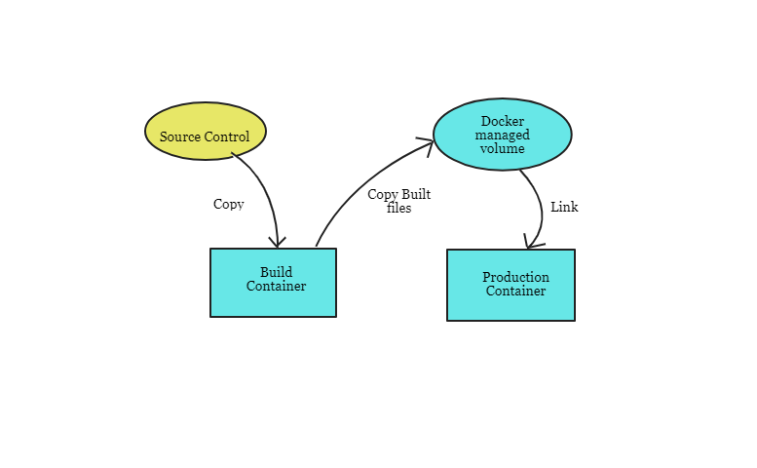
REST API IN CONTAINER
Dockerfile (for REST API)

Slide 42
REST API IN CONTAINER
Dockerfile (for REST API)
# building image
FROM mcr.microsoft.com/dotnet/core/sdk:2.1 AS build-env
WORKDIR /app
# Copy csproj and restore as distinct layers
COPY *.csproj ./
RUN dotnet restore
# Copy everything else and build
COPY . ./
RUN dotnet publish -c Release -o out
# Build runtime image
FROM mcr.microsoft.com/dotnet/core/aspnet:2.1
WORKDIR /app
COPY --from=build-env /app/out .
COPY model/model.zip model/
ENTRYPOINT ["dotnet", "ml-net-webapi-test.dll"]

Slide 43
ML.NET building REST API
DEMO

Slide 44
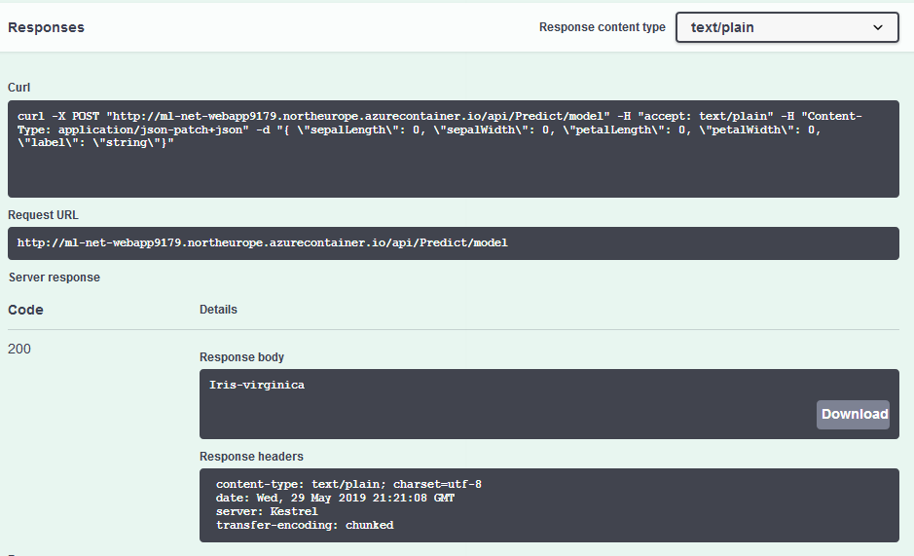
ML.NET building REST API

Slide 45
ML.NET Documentation
https://dotnet.microsoft.com/apps/machinelearning-ai/ml-dotnet
https://github.com/dotnet/machinelearning/blob/master/docs/code/MlNetCookBook.md
https://github.com/dotnet/machinelearning-samples/tree/master/samples/csharp
https://github.com/dotnet/cli
https://github.com/dotnet/machinelearning

Slide 46
ML.NET extensions
ONNX (Open Neural Network Exchange)
https://github.com/onnx/onnx
TENSORFLOW
https://www.tensorflow.org/
Infer.NET is a framework for running Bayesian inference in graphical models. https://dotnet.github.io/infer/

Slide 47
ML.NET WHAT NEXT TO DO
TODO LIST:
Use model with Azure Functions (serverless)
Build model in python and use it in ML.NET with ONNX.
Build model in ML.NET and use it in python (also in Docker).
Use transfer learning to consume ready models.
Make stress tests to check different scenarios and their performance.

Slide 48

Any questions ?

